Slide 1
Mental Wellbeing
Talk to inspire ideas for positive wellbeing

Slide 2
Introduction
Mental Health Nurse – Cambridge and Peterborough Foundation Trust
Adults – inpatient – community – family/Carer work – psychosis work – crisis work – Teaching and training – Suicide mitigation Lead (training)

Slide 3
Aims
Understand Mental wellbeing and resilience
Understand what impacts on our wellbeing
Understand what may help to optimise our wellbeing
Provide information for support available to you
Please write down any questions you may have to discuss at the end

Slide 4
No health without mental health
Public Health Matters
World Health Organisation/DOH
Depression – leading causes of disability
Suicide 2nd leading cause of death among 15-29 year olds
Premature deaths from those with Mental Health conditions
We must work together to increase awareness, understanding and reduce stigma

Slide 5
What Factors Impact upon our Mental Health?
Early experiences (attachment)
Genetic Factors
Stress Management
Drugs and Alcohol
Lifestyle (exercise, relationships)
Resilience

Slide 6
Statistics – 1 in 3

Slide 7
Mental Health Challenges
Depression
Anxiety
Psychosis
Schizophrenia
Bipolar Affective Disorder
Personality Disorder
Eating Disorders
Addiction

Slide 8
Impact of Covid 19 – four phases
Acute Uncertainty – analyse and catastrophise
High emotion, shock, hyper alert or more withdrawn – draining of energy
Prioritise – to maintain energy and assess the new
Disruption – fear, anger and sadness
Negative emotions, helplessness, exhaustion
Prioritise – Social connections, purpose, work on resilience
Adaption – Explore, experiment and understand
Emotional reactions are reduced, more clear headed, decision making improves
Prioritise – Building resilience
Conversation and collaboration
New Normal – Adapt, accept and be productive
Usual Emotional State – levels of wellbeing
Prioritise – Constant review of standard wellbeing practices – energy and resilience
For further reading see www.robersoncooper.com

Slide 9
Acknowledging the present time (Nov 2020)
COVID-19 has challenged our mental health and wellbeing like never before; everything about our world of work has been turned upside-down.
Uncertainty and insecurity about health, finances, our work and our families are challenging each and every one of us, and the emotional impact is becoming very real for many of us.

Slide 10
Bio-Psycho-Social Model

Slide 12
Stigma

Slide 15
Balance in life

Slide 16
Resilience – What is it?

Slide 17
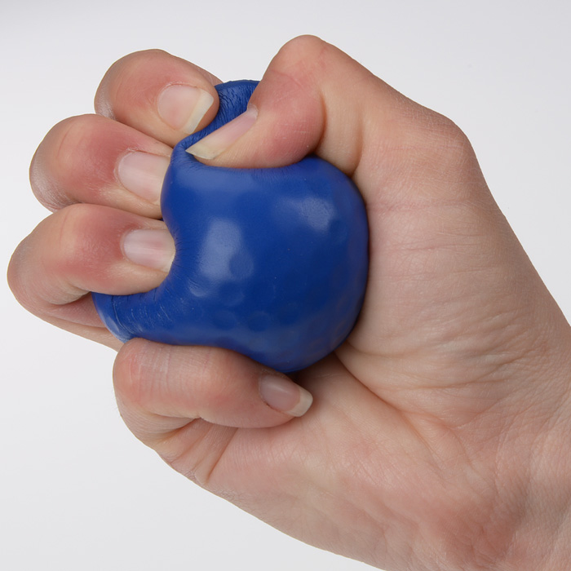
What do we see here?

Slide 18
Good Mental Health

Slide 19
Benefits of exercise

Slide 20
What can you do to ensure Good Mental Health?

Slide 22
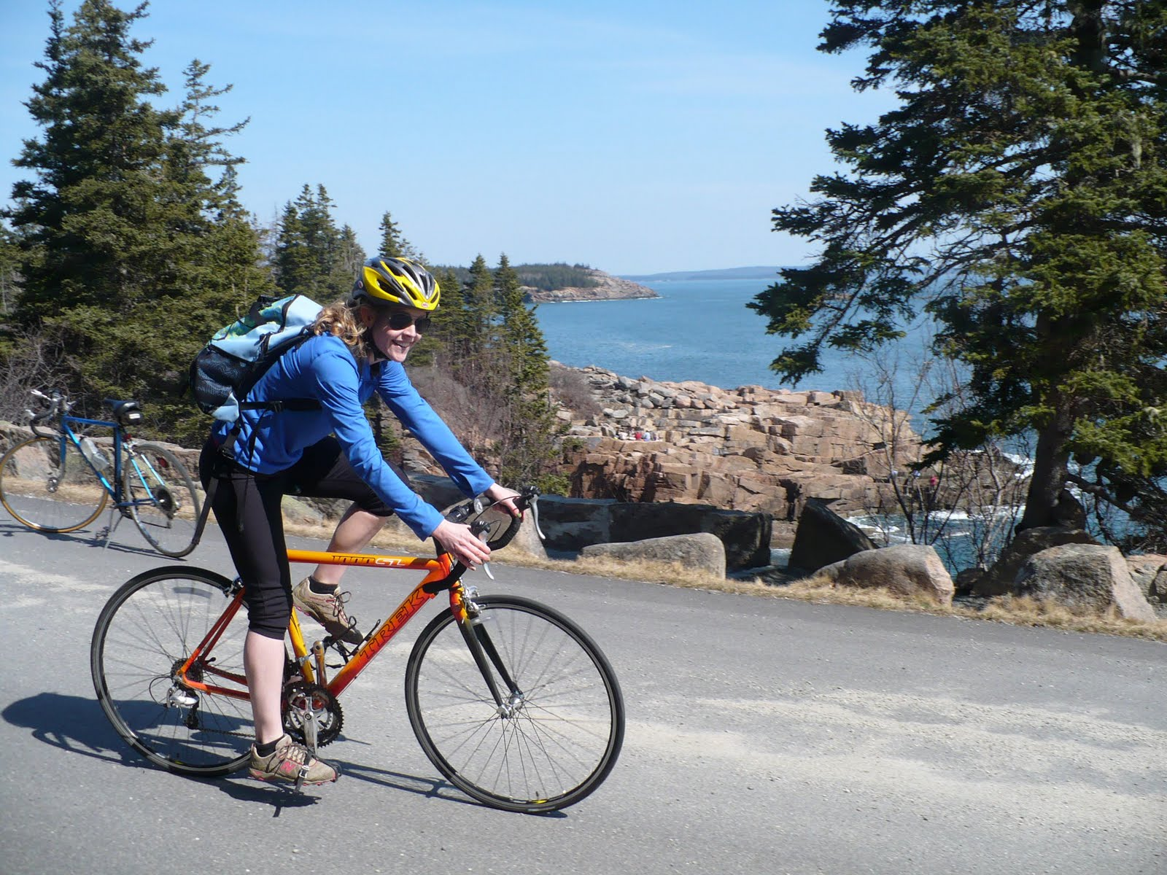
Meaning and Purpose – feel good stuff
This Photo by Unknown Author is licensed under CC BY-SA
This Photo by Unknown Author is licensed under CC BY-SA
This Photo by Unknown Author is licensed under CC BY-NC-ND

Slide 23
Further Information
Self help material
www.getselfhelp.co.uk
Sleep apps
Exercise apps
Mood apps
Groups on social media
www.stayingsafe.net
Mindfulness groups/apps/music

Slide 24
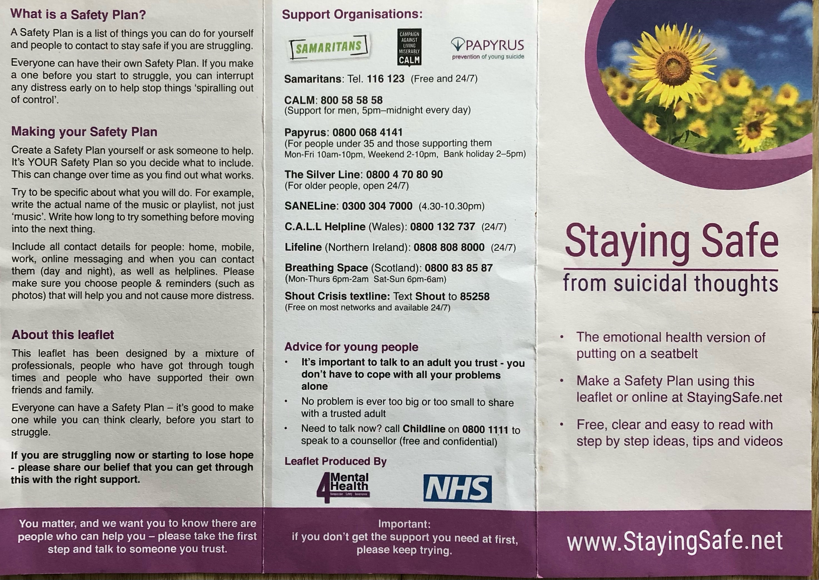

Slide 25
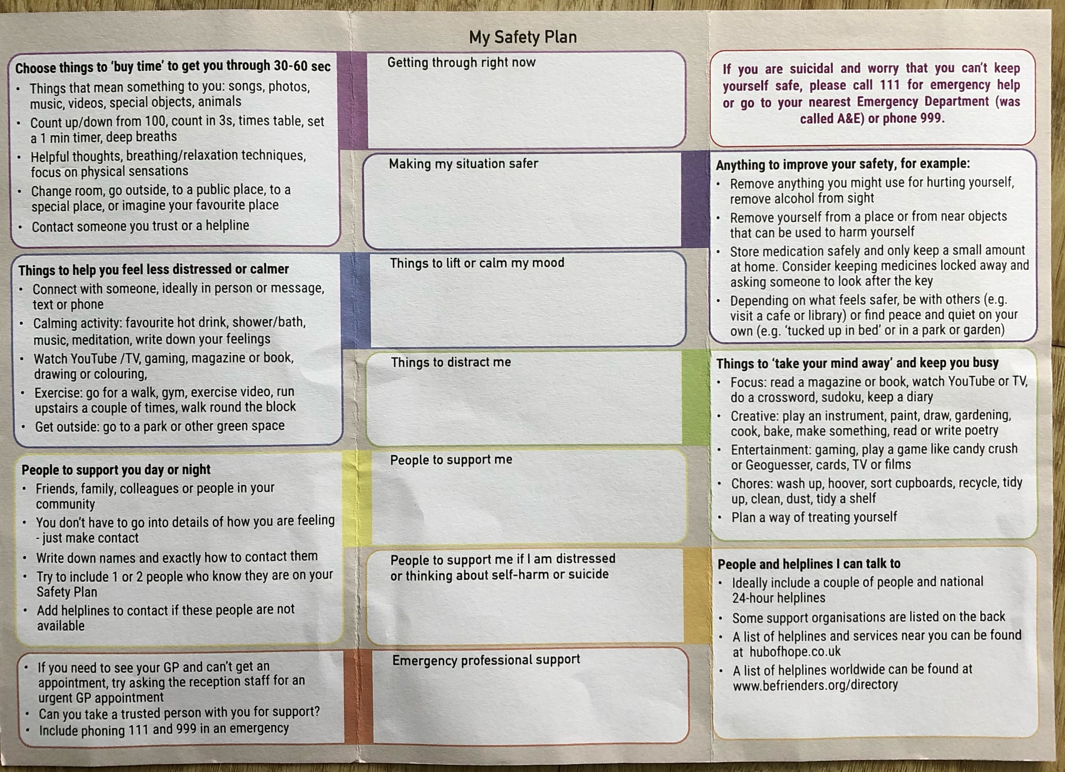

Slide 26
Professional Help
GP
NHS – 111 option 2 (urgent mental health support)
Accident and emergency
College/Work Counsellors
MIND/Rethink/Centre 33
CBT Therapist
Counsellor
Mental Health Professional (Psychologist, Psychiatrist, Nurse, Social Worker, Occupational Therapist)

Slide 27
Care and compassion for self and others

